Slide 1
CDS Spreads and Sovereign Debt Ratings
Krishnan Dandapani
Edward R. Lawrence
Ivan M. Rodriguez, Jr.

Slide 2
Motivation
Prior literature, most notably Packer and Cantor (1996), has been able to identify most of the key macroeconomic variables that explain the major rating agencies decisions when it come to sovereign ratings.
However, there has been a great deal of financial innovation over the last 10 years.
One of the most popular financial instruments that has risen to prominence over the last 10 years is the sovereign credit default swap.
In this paper, we include the lagged 3 year average return as a key variable in the Cantor Packer regression function.
We find that information contained in the average credit default swap spread over the last two years is a major determinant in explain the rating agencies’ methodologies.

Slide 3
Key Prior Literature
Hull, Predescu, and White (2004)
Relationship between CDS spreads and corporate ratings
Find that CDS provides helpful information in estimating the probability of negative credit rating changes.
Cantor and Packer (1996)
Test model with 8 macroeconomic variables
Regress ratings (Average, Moody’s, S&P, Difference) on the macro variables
6 of these are found to significant

Slide 4
Variable Definition

Slide 5
Replication Results (2012)

Slide 6
Notes
With an updated data set
Some of the macro factors are important, but the individual impact has fallen
Does the CDS spread contain more information than these macroeconomic variables?

Slide 7
How Well Does CDS do in Explaining Average Ratings?

Slide 8
Adding Control Variables

Slide 9
Correlation Between Variables

Slide 10
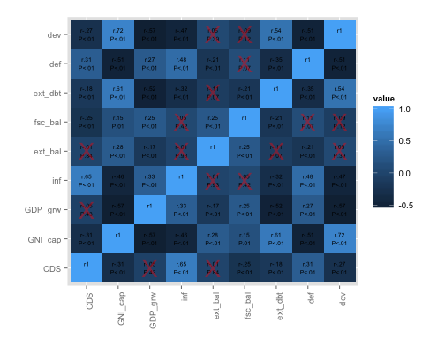
Correlation Between Variables

Slide 11
Variance Inflation Factor

